Slide 1

Sixth Edition
Chapter 6
Research Strategies
and Validity

Slide 2
6.1 Research Strategies
Refers to the general approach and goals of a research study
  The selection of a research strategy is usually determined by:
    the kind of question you plan to address and what you hope to accomplish.

Slide 3
The Descriptive Research Strategy
Describes individual variables (rather than a relationship between variables)
Obtains a snapshot (a description) of specific characteristics of a specific group of individuals
Data are usually in the form of averages or percentages.

Slide 4
Strategies that Examine Relationships between Variables
Most research examines the relationship between variables.
  Changes in one variable are accompanied by changes in another variable.
Relationships between variables may be:
  linear
  curvilinear
  positive
  negative

Slide 5
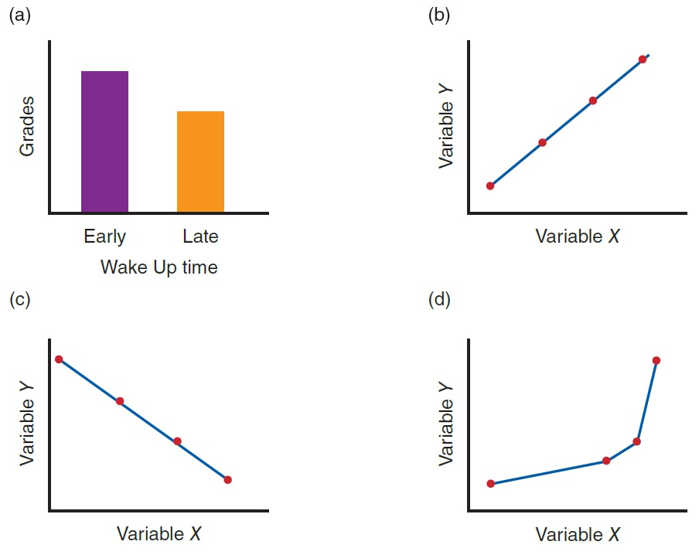
Different Types of Relationships between Variables
Notes:
Figure 6.1 Examples of Different Types of Relationships between Variables: (a) A General Relationship, (b) Positive Linear, (c) Negative Linear, and (d) Positive Curvilinear

Slide 6
The Correlational Research Strategy
Measures two variables for each individual
  Example: relationship between GPA and sleep habits (wake-up time) for college students
Consistent patterns are better seen in a graph called a scatter plot.
  Each individual is represented by a point.
Correlation does not imply causation.
  It describes a relationship, but does not explain it.

Slide 7
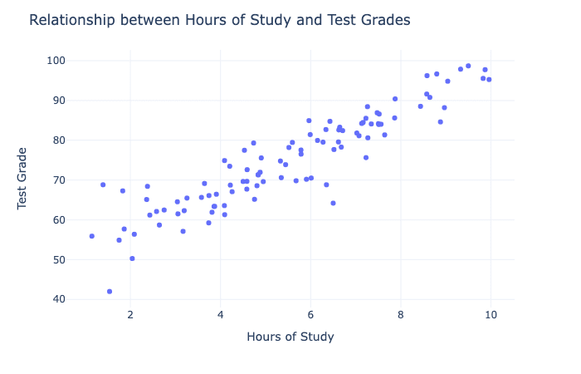
The Correlational Research Strategy
Notes:
Why use correlations?

Slide 8
Comparing Two or More Sets of Scores
The experimental, quasi-experimental, and nonexperimental research strategies
Compares two or more groups of scores
  One of the variables differentiates the groups.
  The second variable measured obtains a score for each individual.

Slide 9
Comparing Grades: Students from High- and Low-Income Families
High Income |  | Low Income
72 |  | 83
86 |  | 89
81 |  | 94
78 |  | 90
85 |  | 97
80 |  | 89
91 |  | 95
? | Compare two groups | ?
Notes:
Mean 1 = 81.9
Mean 2 = Mean = 91.0
Table 6.1 High School Grades for Students from High- and Low-Income Families

Slide 10
Strategies: Experimental, Quasi-Experimental, and Nonexperimental
Experimental research strategy
  Answers cause-and-effect questions about the relationship between two variables
Quasi-experimental research strategy
  Almost, but not quite, experiments—can never produce an unambiguous explanation
Nonexperimental research strategy
  Demonstrates a relationship between variables—does not attempt to explain it

Slide 11
Nonexperimental and Correlational Research
Same goal
  Both are designed to demonstrate that a relationship exists between two variables.
    Do not try to explain the relationship.
Types of data differ
  Correlational uses one group of participants.
    Measures two variables for each person
  Nonexperimental compares two groups of scores; measures only one variable for each individual.

Slide 12
Research Strategy Summary (1 of 2)
Five research strategies
  Category 1: Strategies that examine individual variables
    Descriptive
  Category 2: Strategies that examine relationships between variables by measuring two (or more) variables for each participant
    Correlational

Slide 13
Research Strategy Summary (2 of 2)
  Category 3: strategies that examine relationships between variables by comparing two (or more) groups of scores
    Experimental
    Quasi-experimental
    Nonexperimental

Slide 14
Category 1: Descriptive
Purpose: produce a description of individual variables as they exist within a specific group
Data: a list of scores obtained by measuring each individual in the group being studied
  Example: On average, local college students study 12.5 hours outside of class each week and get 7.2 hours of sleep each night.

Slide 15
Category 2: Correlational
Purpose: produce a description of the relationship between two variables but do not attempt to explain the relationship
Data: measure two variables (two scores) for each individual in the group being studied
  Example: There is a relationship between wake-up times and GPA for college students, but we don’t know why.

Slide 16
Category 3: Experimental
Purpose: produce a cause-and-effect explanation for the relationship between two variables
Data: create two treatment conditions by changing the level of one variable; then measure a second variable for the participants in each condition
  Example: Increasing the amount of exercise causes a decrease in cholesterol levels.

Slide 17
Category 3: Quasi-Experimental
Purpose: Attempt to produce a cause-and-effect explanation, but fall short
Data: Measure before/after scores for one group that receives a treatment and for a different group that does not receive the treatment
  Example: The treatment may cause a reduction in smoking behavior, but the reduced smoking may be caused by something else.

Slide 18
Category 3: Nonexperimental
Purpose: produce a description of the relationship between two variables but do not attempt to explain the relationship
Data: measure scores for two different groups of participants or for one group at two different times
  Example: There is a relationship between gender and verbal ability: girls tend to have higher verbal skills than boys, but we don’t know why.

Slide 19
Research Designs
Require decisions about three basic aspects of the research study:
  Group versus individual
  Same individuals versus different individuals
  The number of variables to be included
Provide a general framework for conducting studies

Slide 20
Research Procedures
Details about how the study is to be done
  Exact, step-by-step description of a specific research study
Includes a determination of:
  Exactly how the variables will be manipulated, regulated, and measured
  Exactly how many individuals will be involved
  Exactly how the individual participants will proceed through the course of the study

Slide 21
Data Structures and Statistical Analysis (1 of 2)
Experimental, quasi-experimental, and nonexperimental studies
  All involve comparing groups of scores.
    Use similar statistical techniques (e.g., t-tests, analysis of variance, and chi-square tests)
Correlational studies
  Numerical scores: analyzed with a correlation calculation (e.g., the Pearson correlation)
  Nonnumerical data: evaluated using chi-square test

Slide 22
Data Structures and Statistical Analysis (2 of 2)
Descriptive studies summarize single variables for a specific group of individuals.
  Numerical data: analyzed by a statistical calculation of the mean score
  Nonnumerical data: evaluated by a report of the percentage associated with each category

Slide 23
Validity and the Quality of a Research Study
Determined by the extent to which the study satisfies the criteria of internal and external validity
Threat to validity
  Any factor that generates doubts about the accuracy of the results or raises questions about the interpretation of the results

Slide 24
Internal and External Validity
What is external validity?
  The extent to which the results of a research study can be generalized
A threat to external validity
  Any characteristic of a study that limits the ability to generalize the study’s results

Slide 25
External Validity
What are three different kinds of generalization, each of which can involve threats to external validity?
  Generalization from a sample to the general population
  Generalization from one research study to another
  Generalization from a research study to a real-world situation

Slide 26
Internal Validity
Concerned with factors in the research study that raise doubts or questions about the interpretation of the results
A research study with internal validity:
  Produces a single, unambiguous explanation for the relationship between two variables
Threat to internal validity
  Any factor that allows an alternative explanation for the results

Slide 27
Implications of Threats to Validity
Research studies vary in terms of validity.
  Never accept a research result or conclusion as true simply because it has been “scientifically demonstrated.”
Being aware of threats to validity can help you critically evaluate a research study.
  Make your own decisions about a research report’s validity and quality.

Slide 28
Threats to External Validity
Any characteristic of the study that limits the generalizability of the results
Three general categories
  Category 1: generalizing across participants or subjects
  Category 2: generalizing across features of a study
  Category 3: generalizing across features of the measures

Slide 29
Threats to Generalizing across Participants or Subjects
Selection bias
Overutilizing college students
Volunteer bias
Participant characteristics

Slide 30
Threats to Generalizing across Features of a Study
Novelty effects
Multiple treatment interference
  Fatigue
  Practice
Experimenter characteristics

Slide 31
Threats to Generalizing across Features of the Measures
Sensitization
Generality across response measures
Time of measurement

Slide 32
Threats to Internal Validity
What are extraneous variables?
  Any variables in a research study other than the specific variables being studied
Confounding variables are extraneous variables (usually unmonitored).
  Provide an alternative explanation for the observed relationship between the two variables

Slide 33
Extraneous Variables, Confounding Variables, and Internal Validity
Environmental variables
  General threats for all designs
Participant variables
  Individual difference
Time-related variables
  Threats for designs that compare one group over time

Slide 34
More About Internal and External Validity
Goal of any research study ► maximize internal and external validity
Balancing internal and external validity
  There tends to be a trade-off between internal and external validity
  The purpose or goals of a study help you decide which type of validity is more important and which threats must be addressed.

